Slide 1
SCAFFOLD
Prajwal Thaware

Slide 2
Problem Statement
Orchestration of Clusters is a manual, high-touch process that consumes significant engineering time.
Engineers must manually execute SALT calls, configure replication, and validate cluster status.
Multiple sequential steps across different tools creates opportunities for human error and inconsistencies.

Slide 3
Solution
The automation platform streamlines the deployment through a template-driven web interface that handles the complete lifecycle automatically.
Jenkins and Ansible orchestrate all steps from cluster initialization to cluster verification.
This standardized approach reduces the deployment time, eliminates human error and enables to deploy clusters confidently.

Slide 4
Key Features
Template-Driven Deployment
- Reusable configurations with approval workflow
Automated Prechecks
- Validates infrastructure before deployment
Smart Disk Allocation
- Calculates optimal partition sizes automatically
Real-time Monitoring
- Live status updates and console log streaming

Slide 5
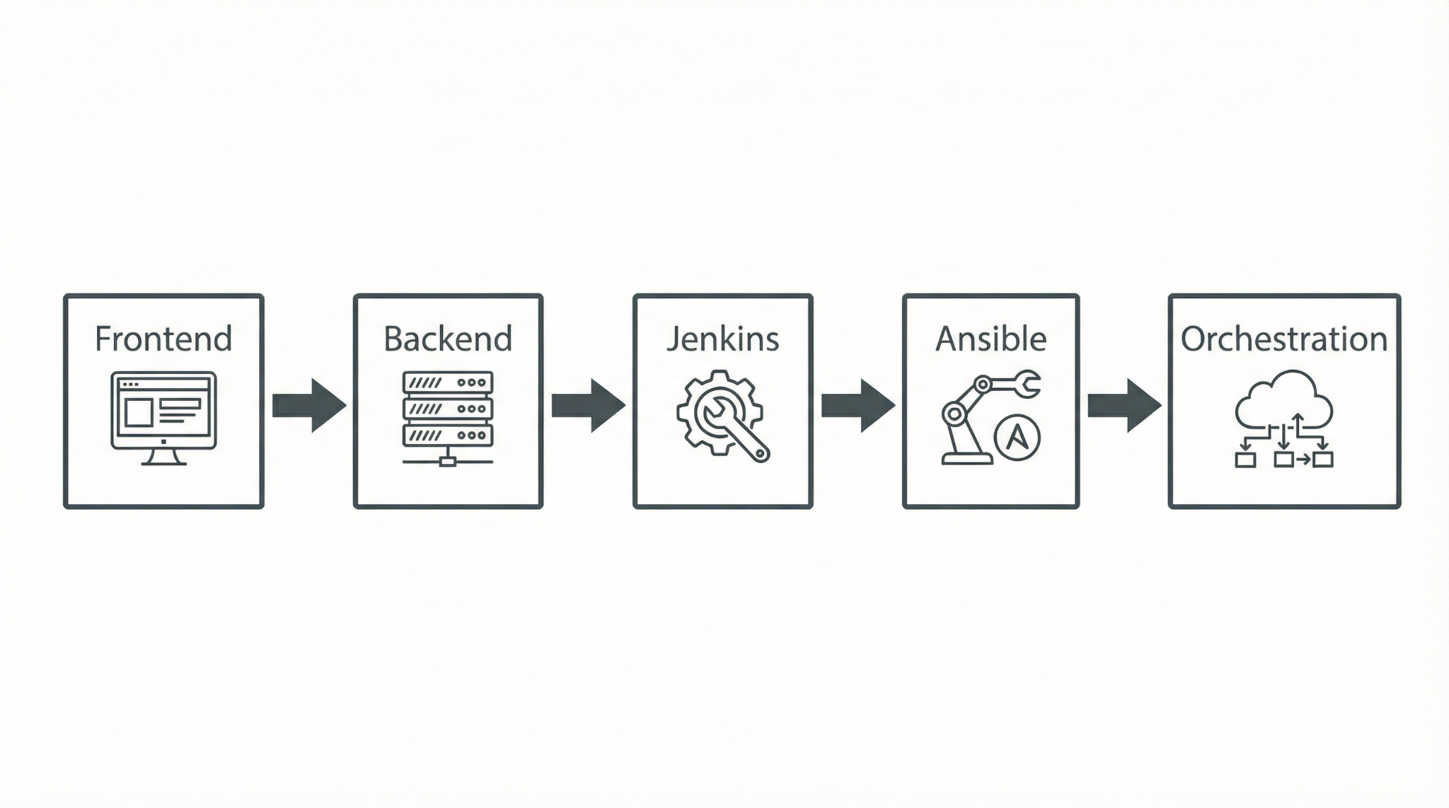
System Architecture Overview

Slide 6
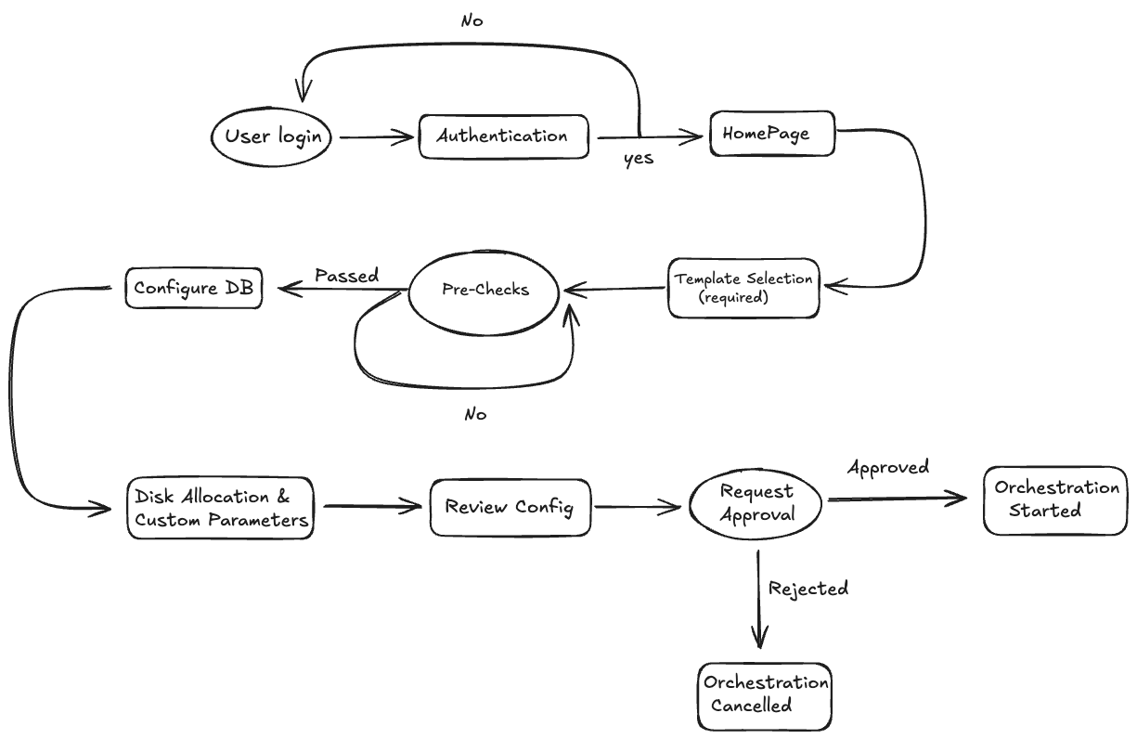
Flowchart - Web-UI

Slide 7
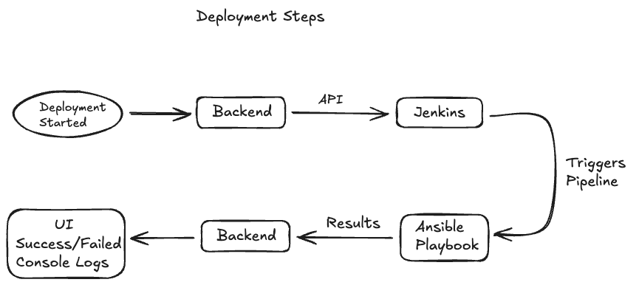
Flowchart

Slide 8
Future scope
Extend the platform to support additional databases like ElasticSearch, Aerospike and queues like RabbitMQ.
Integrate monitoring system with the deployed cluster.

Slide 9
Thank you

